Slide 1


Cybersecurity Threats
That Target organization
What are the Top Cybersecurity Threats for companies?
What Should be done for Cybersecurity Threats?

Slide 2

Sections
01
General Information
02
Top Cybersecurity Threats
03
Solutions Of Cybersecurity Threats

Slide 3


General Information
A cybersecurity threat is the threat of malicious attack by an individual or organization attempting to gain access to a network, to corrupt data or steal confidential information. No company is immune from cyber attacks and the data breaches that can result. Some cyberattacks can even destroy computer systems.
Today’s most damaging security threats do not originate from malicious outsiders or malware but from trusted insiders with access to sensitive data and systems - both malicious insiders and negligent insiders

Slide 4
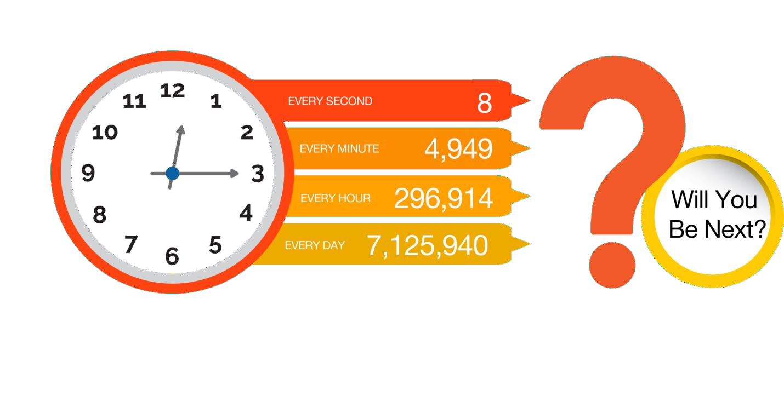
STOLEN DATA RECORDS FREQUENCY
43% of
the successful breaches were linked to internal actors
2.6 billion
records breached in 2017
81% of
breaches due to stolen passwords
$3.86 M
Average cost of a
data breach
Confidential KRONTECH©2019
4

Slide 5

Four signs that your organization is at risk
Employees are not trained to fully understand and apply laws, mandates, or regulatory requirements
the devices that belong to employees use are not secure
Employees are sending highly confidential data to an unsecured location in the cloud, exposing the organization to risk.
Employees break your organization’s security policies to simplify tasks.

Slide 6
Sections
01
General Information
02
Top Cybersecurity Threats
03
Solutions Of Cybersecurity Threats

Slide 7

Social Engineering
Basic Web Application Attacks
System Intrusion
Miscellaneous Errors
Top Threats
Privilege Misuse
Lost and Stolen Assets
Denial of Service
Everything Else

Slide 8
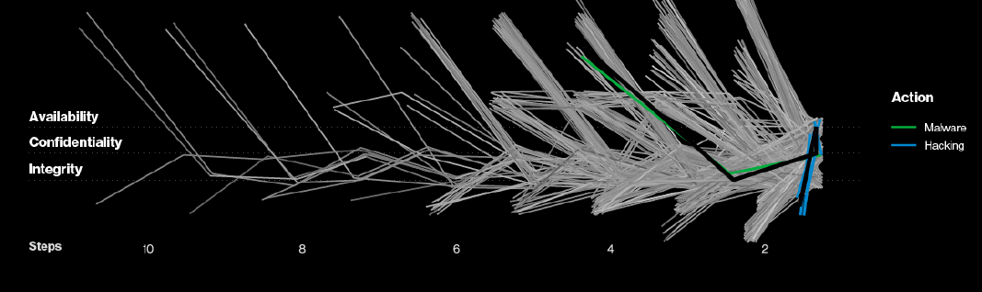
Social Engineering
Explain
Social engineering is the term used for a broad range of malicious activities accomplished through human interactions
Examples
Spam emails
Phishing emails
Spear phishing emails

Slide 9
Basic Web Application Attacks
Explain
the basic web application attack techniques that saboteurs are using tend to be the same ones they’ve been relying on for years, especially these five.
Examples
Injection Attacks
Brute Force
MITM Attack

Slide 10
System Intrusion
Explain
This new pattern consists of more complex attacks, typically involving numerous steps. The majority of these attacks involve Malware.
Examples
Worms
Ransomware variety
RDP Attack

Slide 11
Miscellaneous Errors
Explain
Errors is vulnerable for hackers because hackers can easily find a way to hack.
Examples
Website domain error

Slide 12
Privilege Misuse
Explain
Privilege abuse was the most common action type for this pattern, with the majority of actors being Financially motivated. The most common data type stolen was Personal information, and somewhat surprisingly, the rise in remote workers did not appear to have a noticeable effect on Misuse.
Examples
Wicked Internal Actor
Negligent Internal Actor

Slide 13
Lost and Stolen Assets
Explain
Devices continue to be lost or stolen, a pattern that is unlikely to change anytime soon. While the actor may be Internal (for loss) or External (for theft), the controls to protect the data on these devices remain constant.
Examples
Wicked Technical Insider
Fire
Tornado

Slide 14
Denial of Service
Explain
The Denial of Service pattern consists of attacks intended to compromise the availability of networks and systems.
Examples
DoS
DDos

Slide 15
Sections
01
General Information
02
Top Cybersecurity Threats
03
Solutions Of Cybersecurity Threats

Slide 16

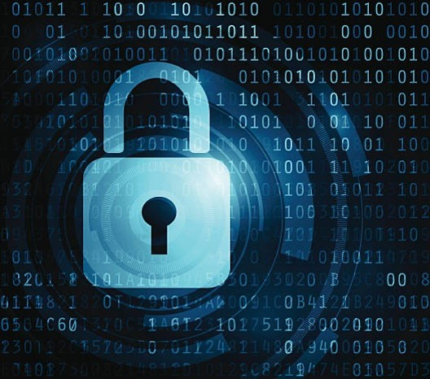
Actually there is no solution that works 100% and can solve all

Slide 17

How to minimize the risk of insider threats?

Slide 18

Solution Ways
Perform enterprise-wide risk assessments.
Clearly document and consistently enforce policies and controls.
Establish physical security in the work environment.
Implement security software and appliances.
Monitor and control remote access from all endpoints, including mobile devices.
Harden network perimeter security.

Slide 19
Solution Ways
Enable surveillance.
Enforce separation of duties and least privilege.
Recycle your old hardware and documentation properly.
Use a log correlation engine or security information and event management system (SIEM) to log, monitor and audit employee actions.
Identify risky actors and respond promptly to suspicious behavior.

Slide 20
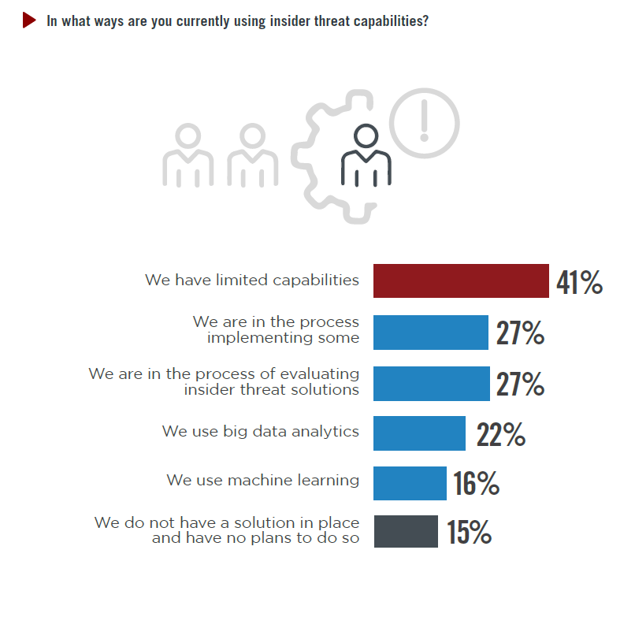

Slide 21
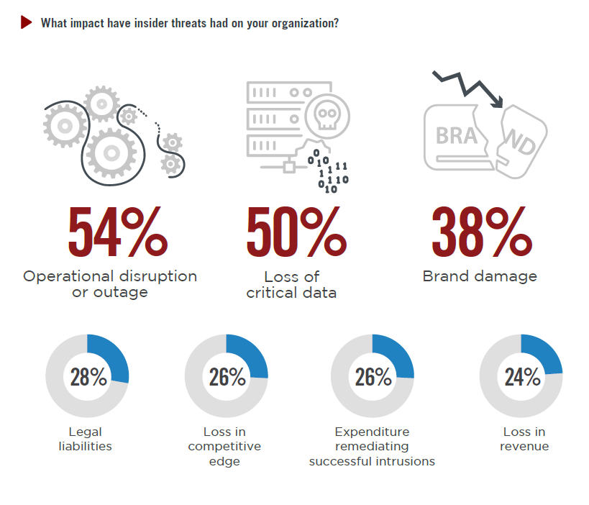

Slide 22
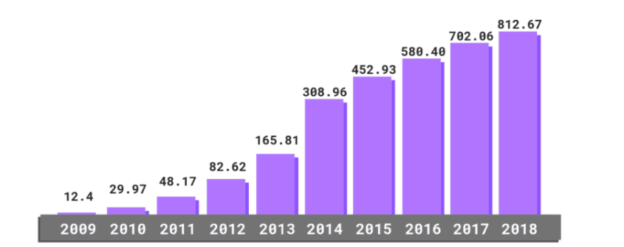

Slide 23
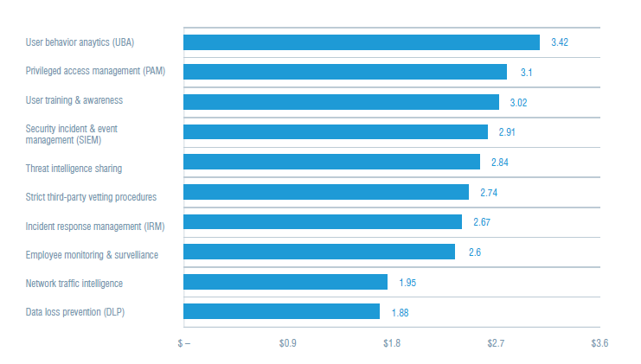
How to minimize the risk of insider threats?

